Slide 1
Introduction to ISDN

Slide 2
What is ISDN?
ISDN - Integrated Services Digital Network
Telephone services →Telecommunication services integrate digital voice, 64-kbps data, telex, fax, slow-scan video
local interface to a “digital pipe”enables higher data rates
Notes:
used for studo quality sound and moving images

Slide 3
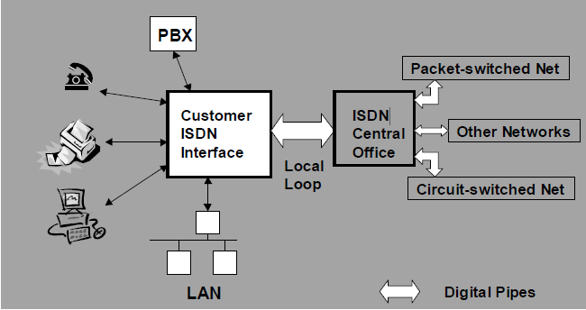
ISDN view
Notes:
E series - international numbering plan, international ISDN addressing
I series - concepts, structures, terminology, User-network interfaces

Slide 4
Fundamentals
Types of channels
  Bearer channel (B-channel=64 kb/s) clear pipe for data
  Delta channel (D-channel, 16 kb/s or 64 kb/s) call signaling information:
    who is calling
    type of call
    calling what number

Slide 5

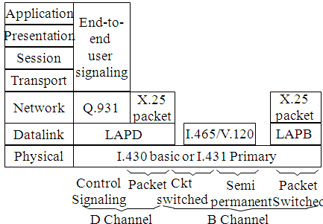
ISDN protocol architecture

Slide 6
Fundamentals
Service types
  Basic Rate Interface (2 B channels + 1 D channel (16 kb/s))
  Primary Rate Interface (30 B channels + 1 D channel (64 kb/s))

Slide 7
Advantages of ISDN
Digital
  reliable connection
Speed
  128 kb/s (160 kb/s) for BRI
  1920 kb/s (2048 kb/s) for PRI
Fast call setup
  2 seconds

Slide 8
Advantages of ISDN
Bandwidth on Demand
  adding new channels to the bundle of channels
Multiple devices
  phone, fax, PC, videoconferencing system, router, terminal adapter,.. each with its own sub-address

Slide 9
ISDN and OSI model
Layer1 - Physical
Layer2 - Data Link
Layer3 – Network

Slide 10
Interfaces and Devices
Interfaces
  S/T (4w)
  U (2w)
Devices
  NT1
  TE1 - ISDN devices
  TE2 - analog devices (need TA)
  TA - Terminal Adapter (rate adaptation (V.110, V.120)
Notes:
www.ziplink.net/~ralphb/ISDN/ifces.html

Slide 11
Interfaces and Devices
ISDN devices
TE1
4W
2W
NT1
S/T interface
U interface
TE2
TA
Analog devices:
phone, Fax III,...
Rate adaptation

Slide 12
ISDN Access Servers
Digital modems (accepting analog and ISDN calls)
  software busy-out feature
56 kbit/s technologies
Rate adaptation (V.110, V.120,..)
Compression (Stack,..)
Synchronous PPP (with CHAP/PAP authentication)
Notes:
Samo za terminalski dostop
za prilagajanje hitrosti na <COM port

Slide 13
ISDN Access Servers
PPP Multilink
BACP (Bandwidth Allocation Control Protocol)
Controlling the number of B-channels per user
D-channel based callback
CLIP - Caller Line Identification Presentation

Slide 14

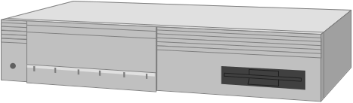


56 k Technology
Analog line
Access server
Digital line
Telephone
switch
?
Telephone
switch
Modem
<= 33,6 kbps
Modem
Telephone
switch
Access server
Modem
<= 56 kbps
<= 33,6 kbps
ISDN, E1,..

Slide 15
Using ISDN for
IP Data Networks
Characteristics
  Speed
  Fast call setup
  Bandwidth on Demand

Slide 16
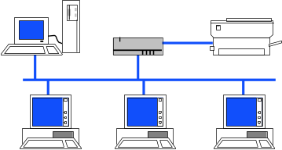
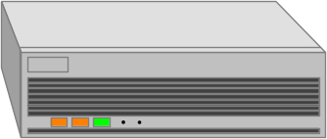
Dial Up - LAN
Internet
ISDN Access Server
LAN
ISDN connection
Telephone
Network
ISDN connection
ISDN router

Slide 17
ISDN Architecture
Network
Subscriber
premises
>64kbps
non-switched
capabilities
>64kbps
switched
capabilities
Digital
subscriber
loop to
C. O.
Subscriber
interface to
ISDN
64kbps
ckt non-switched
capabilities
Terminal
equipment
(TE)
Network
Termination
(NT)
>64kbps
ckt switched
capabilities
Subscriber
site or
service
provider
ISDN
switch
ISDN
switch
Packet switched
capabilities
User-network
signaling
Frame mode
capabilities
Common-
channel signaling
capabilities
User-network
signaling

Slide 18
Transmission Structure
B Channel: 64 kbps
D Channel: 16 or 64 kbps
H Channel: 384 (H0), 1536 (H1), or 1920 (H12) kbps
Basic Rate Interface
Primary Rate Interface

Slide 19
ISDN Channel Structures
B
Information:
Voice, Data
B
Basic
Signaling:
Overhead or
telemetry, etc.
Basic Service:
Management rate: 192 kbps
Standard throughput: 144 kbps
Composition: B + B + D channels,
+ Synch & framing
D
B
B
PCM voice
channels
Primary
Primary Service:
Rate: 1.544/2.048 Mbps
Composition: 2.048 Mbps: 30 B at 64 kbps each
2 D at 64 kbps
1.544 Mbps: 23 B at 64 kbps each
1 D at 64 kbps
B
D
Signaling

